Slide 1
Object Detection in Parking Spaces Using YOLOv5s
Scene Classification
Team :
Vanacharla Bhaskara Vijaya Sai Swamy
Rishikeshwar Kankurthyshetty
Damodhar Reddy Chirapureddy

Slide 2
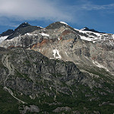
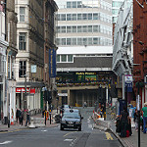
Scene Classification
Task: This dataset contains approximately 25,000 images depicting a wide range of natural scenes from various parts of the world. The task is to categorize each image into one of six scene classes.
Dataset Link: https://www.kaggle.com/datasets/nitishabharathi/scene-classification.
Number of samples, image size:25000,224x224 pixels.
Number of Classes:6 classes: Buildings, Forests, Mountains, Glacier, Street, Sea.
Train, Test, and Validation Partition: Training: 80%,Validation: 10%, testing:10%
Data Normalization: Mean: [0.485, 0.456, 0.406],Standard Deviation: [0.229, 0.224, 0.225]
Samples:
mountains
Buildings

Slide 3
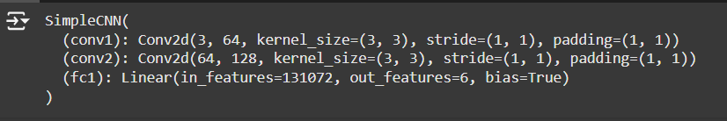
Scene Classification
Architecture :
Mini-batch size:64 Optimization algorithms:Adam optimizer
optimizer = torch.optim.AdamW(model.parameters(), lr=learning_rate, weight_decay=weight_decay)
Hyperparameters:learning_rate,num_layers,num_filters,batch_size,Epochs,weight_decay List other hyperparameters that were tuned:
learning_rate = 0.001
num_layers = 1
num_filters = 64
batch_size = 2
epochs = 1000
weight_decay = 0.01

Slide 4
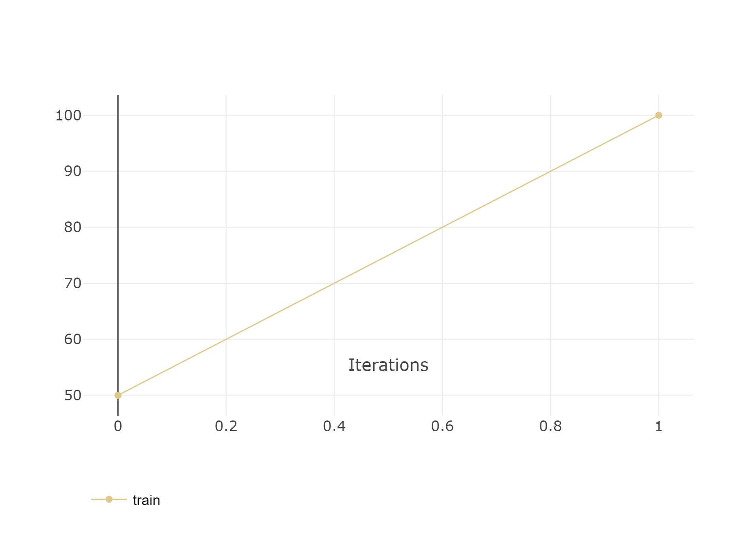
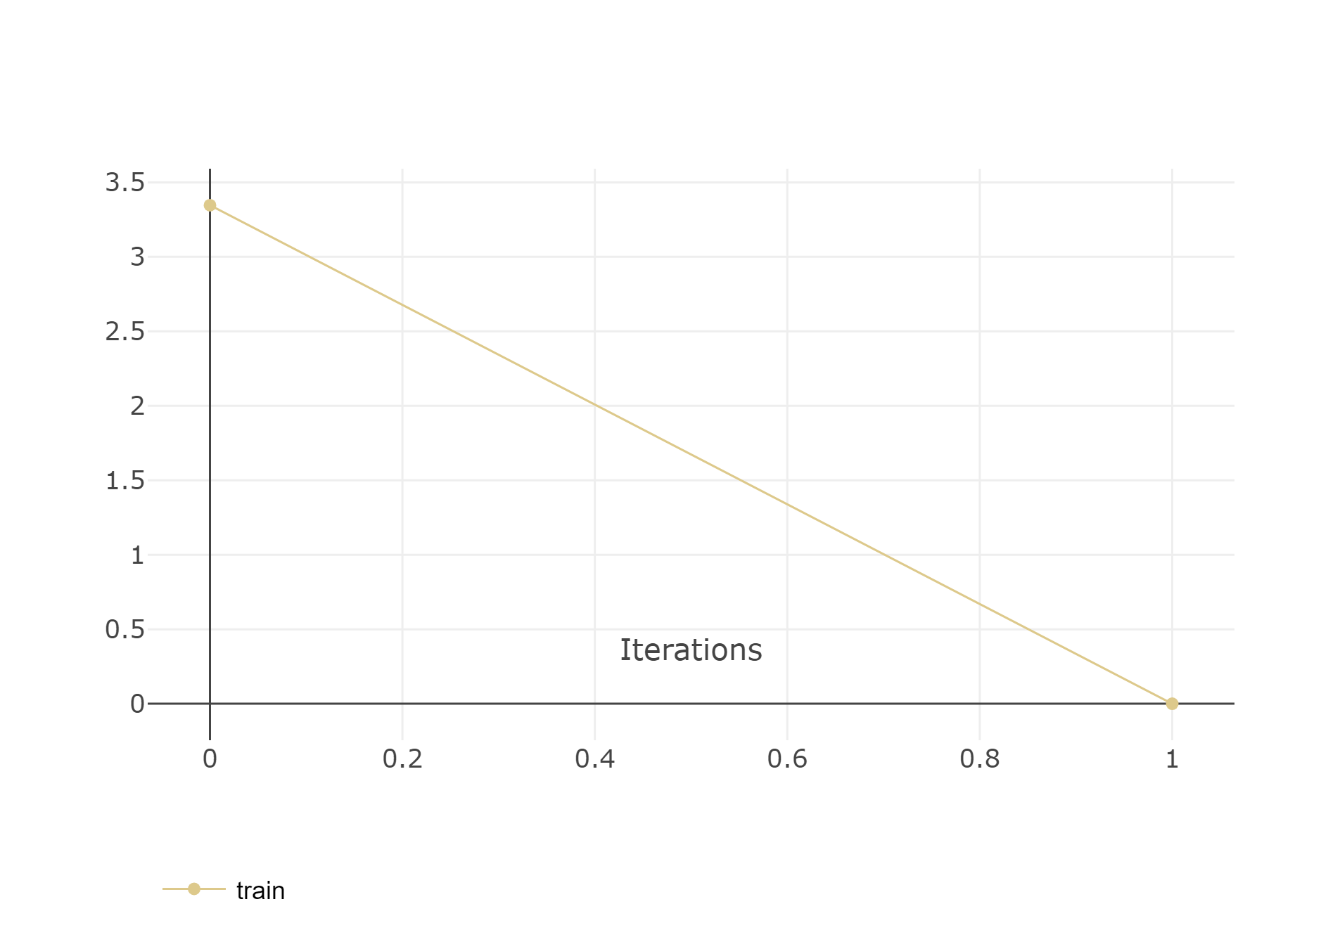
Scene Classification

Slide 5
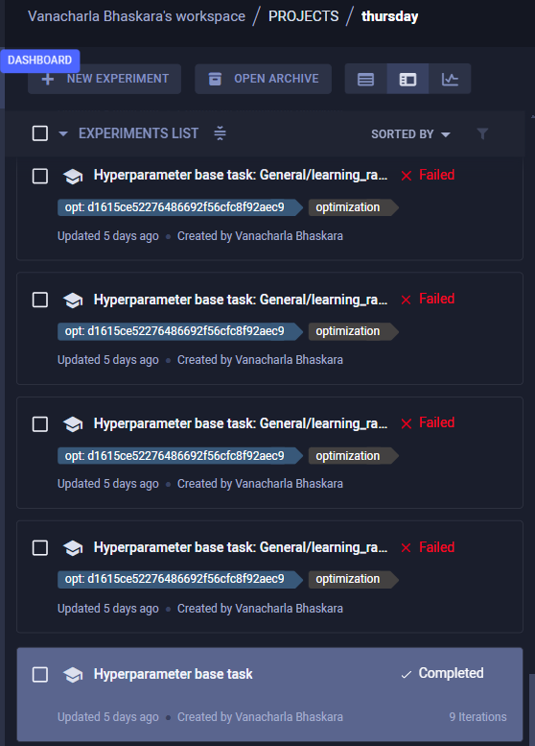
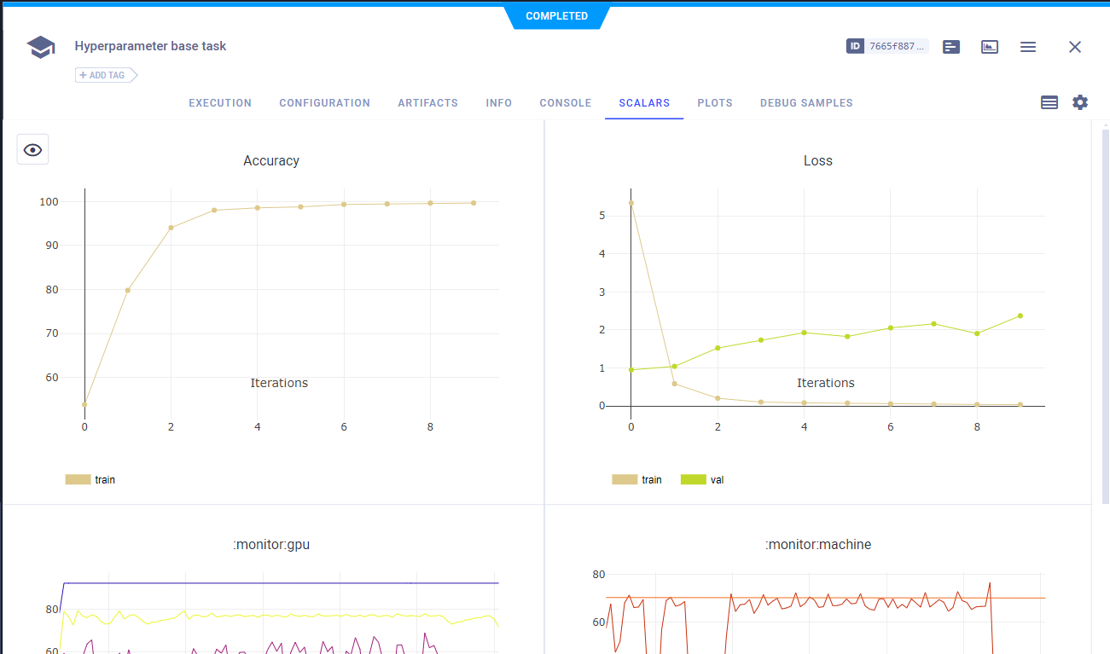
Scene classification
Hyperparameter tuning results

Slide 6
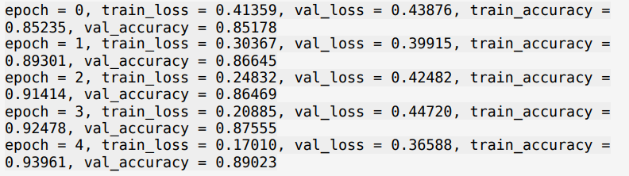
Scene Classification
Transfer Learning:
Experiment setup and Results

Slide 7
Object Detection in Parking Spaces Using YOLOv5s
Data Collection and processing
Task: Parking space detection to identify: Free spaces, Occupied spaces, Partially occupied spaces, Persons
Dataset Source: car parking space link
Created manually and annotated using Roboflow: https://app.roboflow.com/car-parking-space-ndbbs/car-parking-space-tjthw/deploy
Dataset Composition:
Original Images: 200
Augmented Images: 480
Image Size: 640x640 pixels
Number of Classes: 4 {Free Parking Space, Not Free Parking Space, Partially Free Parking Space, Person}
Partitioning: Training: 80%, Validation: 10%,Testing: 10%
Preprocessing and Augmentation:
Preprocessing: Auto-orient images, Resize to 640x640 pixels
Augmentation Techniques: Horizontal and Vertical Flip, Cropping (Zoom Range: 7%–28%),Grayscale applied to 91% of images

Slide 8
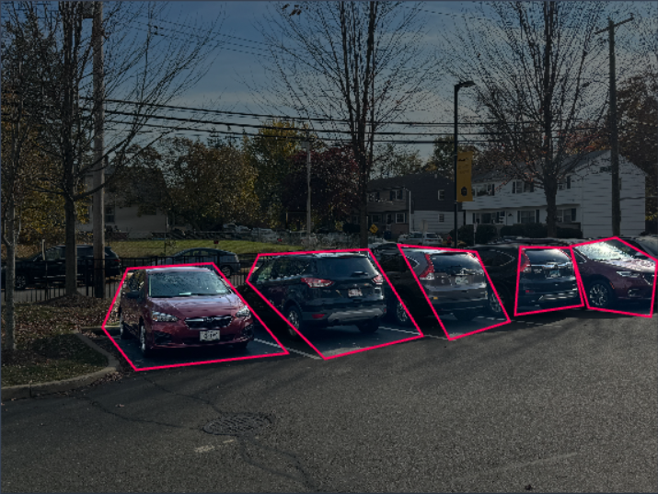
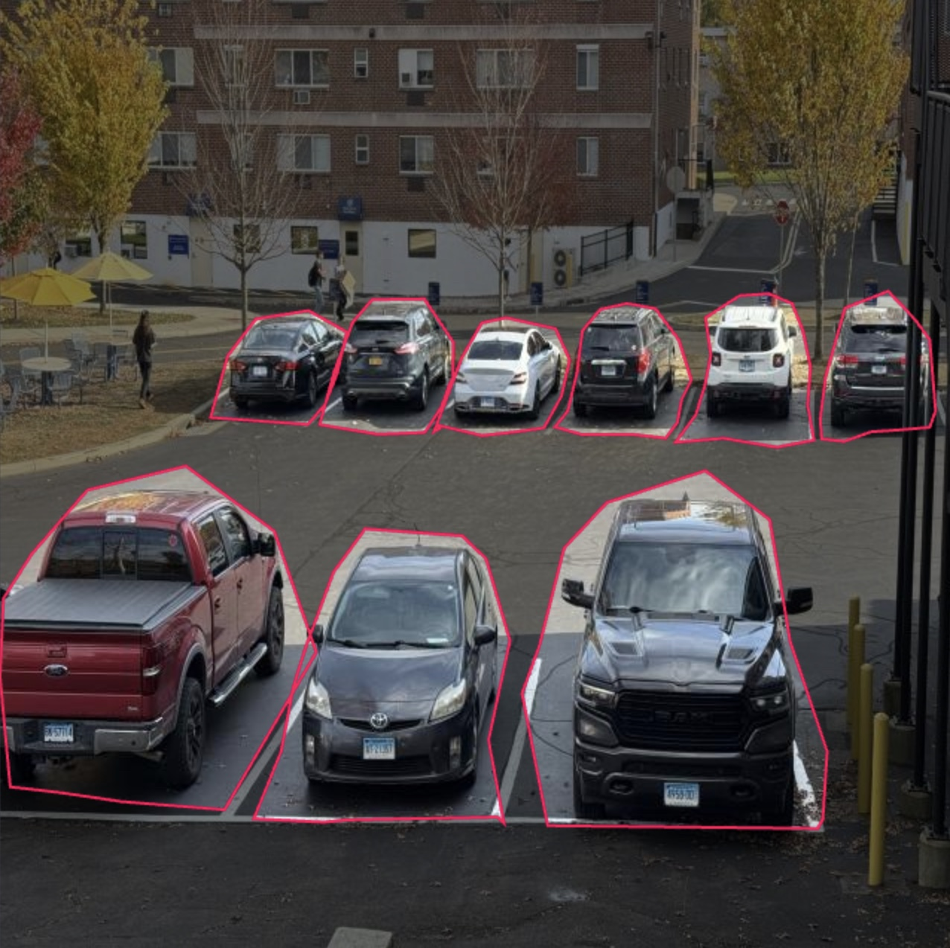
Two sample and Images with Annotations

Slide 9
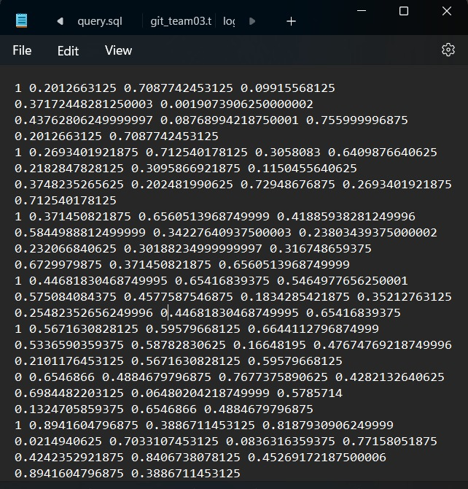
Data Structure of Labels
Class Index | Class Name | x_center | y_center | Width | Height
0 | Free Parking Space | 0.5 | 0.5 | 0.2 | 0.3
1 | Not Free Parking Space | 0.4 | 0.6 | 0.3 | 0.4

Slide 10
YOLOv5s Neural Network Architecture - Part 1
# YOLOv5s (You Only Look Once version 5 small) Architecture
# Parameters:
nc: 4 # number of classes to detect
depth_multiple: 0.33 # model depth multiple
width_multiple: 0.50 # layer channel multiple
anchors:
- [10, 13, 16, 30, 33, 23] # P3/8
- [30, 61, 62, 45, 59, 119] # P4/16
- [116, 90, 156, 198, 373, 326] # P5/32
# YOLOv5 v6.0 Backbone:
- [-1, 1, Conv, [64, 6, 2, 2]] # 0-P1/2: 64 filters, 6x6 kernel size, stride 2, padding 2
- [-1, 1, Conv, [128, 3, 2]] # 1-P2/4: 128 filters, 3x3 kernel size, stride 2
- [-1, 3, C3, [128]] # 2
- [-1, 1, Conv, [256, 3, 2]] # 3-P3/8: 256 filters, 3x3 kernel size, stride 2
- [-1, 6, C3, [256]] # 4
- [-1, 1, Conv, [512, 3, 2]] # 5-P4/16: 512 filters, 3x3 kernel size, stride 2
- [-1, 9, C3, [512]] # 6
- [-1, 1, Conv, [1024, 3, 2]] # 7-P5/32: 1024 filters, 3x3 kernel size, stride 2
- [-1, 3, C3, [1024]] # 8
- [-1, 1, SPPF, [1024, 5]] # 9: Spatial Pyramid Pooling - Fast

Slide 11
YOLOv5s Neural Network Architecture - Part 2
# YOLOv5s v6.0 Head:
- [-1, 1, Conv, [512, 1, 1]] # 10: 1x1 convolution with 512 filters
- [-1, 1, nn.Upsample, [None, 2, 'nearest']] # 11: Upsampling feature map by a factor of 2
- [[-1, 6], 1, Concat, [1]] # 12: Concatenating features from P4
- [-1, 3, C3, [512, False]] # 13: C3 module with 512 channels
- [-1, 1, Conv, [256, 1, 1]] # 14: 1x1 convolution with 256 filters
- [-1, 1, nn.Upsample, [None, 2, 'nearest']] # 15: Upsampling again
- [[-1, 4], 1, Concat, [1]] # 16: Concatenate features from P3
- [-1, 3, C3, [256, False]] # 17: C3 module with 256 channels
- [-1, 1, Conv, [256, 3, 2]] # 18: 3x3 convolution
- [[-1, 14], 1, Concat, [1]] # 19: Concatenate features from P4
- [-1, 3, C3, [512, False]] # 20: C3 module with 512 channels
- [-1, 1, Conv, [512, 3, 2]] # 21: 3x3 convolution
- [[-1, 10], 1, Concat, [1]] # 22: Concatenate features from P5
- [-1, 3, C3, [1024, False]] # 23: C3 module with 1024 channels
- [[17, 20, 23], 1, Detect, [nc, anchors]] # 24: Detection layer

Slide 12
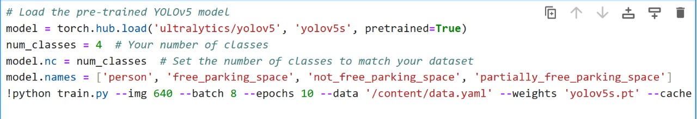
Transfer Learning

Slide 13
Training
Mini-batch Size
Batch Size: 16 The model was trained using a mini-batch size of 16. This means that 16 images were processed together in each training step before the model weights were updated.
Optimization Algorithm and Hyperparameter Settings
Optimization Algorithm:
Stochastic Gradient Descent (SGD) with momentum was used as the optimization algorithm. This is a common choice for training deep learning models, as it helps the model converge faster.
Hyperparameter Settings:
Learning Rate: 0.001 The learning rate controls the step size at each iteration while moving toward a minimum of the loss function.
Weight Decay: 0.0005 Weight decay is used as a regularization technique to avoid overfitting by penalizing large weights.

Slide 14
Hyperparameter Search
The model underwent hyperparameter search to find the optimal set of hyperparameters.
Hyperparameters Tuned:
Learning Rate: Range from 0.001 to 0.01
Momentum: Set at 0.9
Weight Decay: Set at 0.0005
Hyperparameter Tuning Strategies:
Manual tuning was performed to find the best combination of hyperparameters for training the YOLOv5s model.
Hyperparameter Search Results:
Learning Rate: 0.001 was found to be optimal for this dataset.
Momentum: 0.9 worked best for stable convergence.
Weight Decay: 0.0005 provided regularization without overfitting

Slide 15
Pre and Post Training Comparison
Losses Comparison
Training Loss:
Initially, the training loss for bounding box regression, objectness, and classification showed considerable variation due to insufficient training.
Post-training: The loss stabilized after several epochs, indicating the model had learned better feature representations.
Validation Loss:
Pre-training: High validation loss, as the model had not yet learned to generalize well.
Post-training: Validation loss decreased as the model improved its ability to generalize to unseen data.
Test Loss:
Before training: Test loss was high because the model was not yet trained.
After training: Test loss showed improvement, but still required fine-tuning for better performance on certain classes.

Slide 16

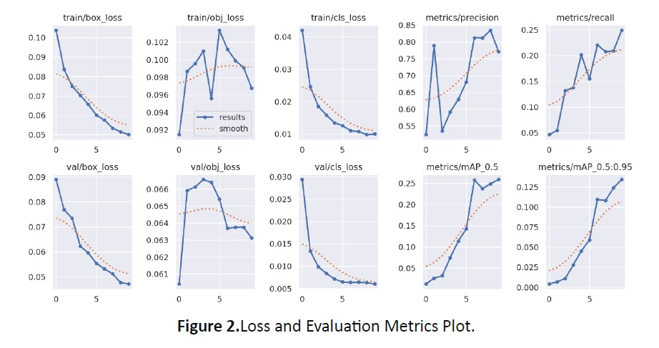

Slide 17
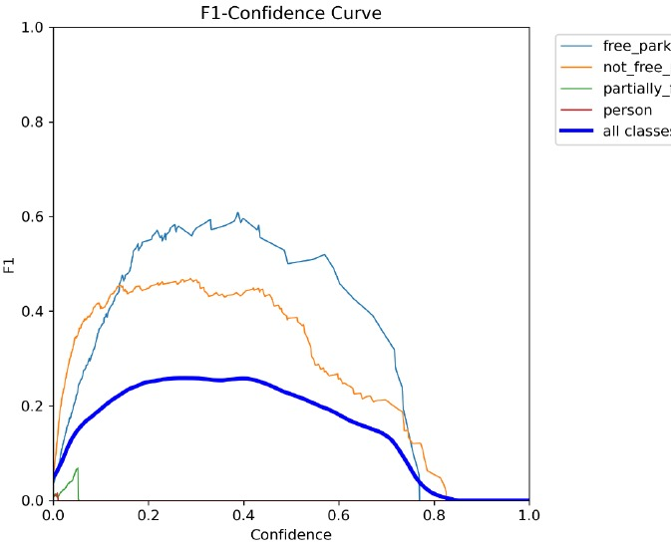
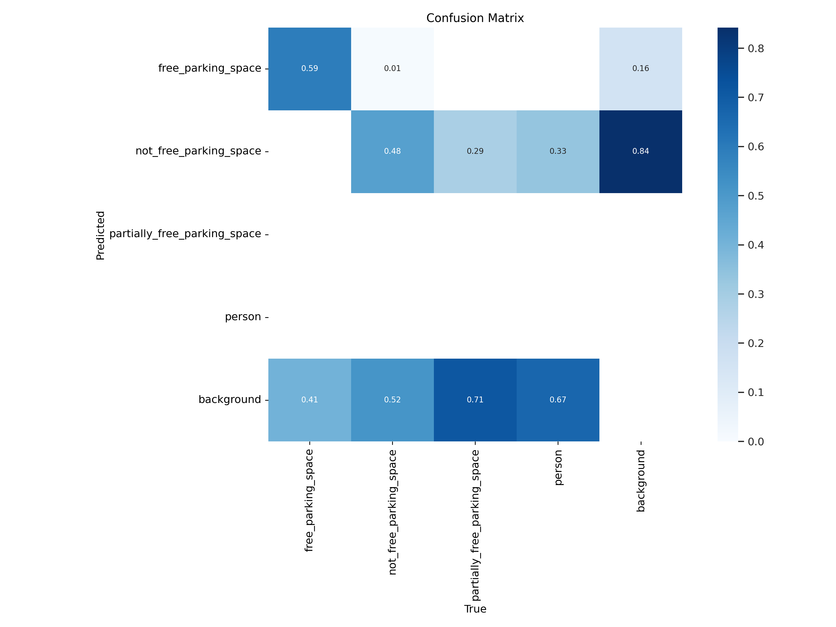

Slide 18
Performance Metrics Comparison (mAP, Precision, Recall)
Mean Average Precision (mAP):
Precision and Recall: The model's precision and recall vary across classes. For example, the free_parking_space class has higher precision (0.617) and recall (0.523), while the person class has both precision and recall of 1, but with very few instances.
⁠Mean Average Precision (mAP): The mAP50 (mean average precision at IoU threshold of 0.5) for the overall dataset is 0.259, with mAP50-95 (across IoU thresholds of 0.5 to 0.95) being 0.134. These are relatively low values, suggesting that the model can be further optimized.
Class-specific Performance: Some classes like not_free_parking_space have lower performance (precision: 0.478, recall: 0.452), indicating that these classes might need more data or adjustments in model parameters.
Free Parking Space (0.59): The model correctly identified free parking spaces 59% of the time.
Not Free Parking Space (0.48): The model correctly identified not free parking spaces 48% of the time.
Remaining Classes (0.00): The model struggled to identify other classes, resulting in 0% accuracy.
Moderate Performance for Free and Not Free Classes: While not as high as desired, the model shows some capability in these areas.
Struggles with Other Classes: Zero accuracy for other classes indicates the model finds it
challenging to differentiate these categories.

Slide 19
Precision:
Free Parking Space (Pre-training): Very low precision as the model could not differentiate well between occupied and free spaces.
Free Parking Space (Post-training): Precision increased to 0.617 after training.
Not Free Parking Space (Pre-training): Low precision of 0.478.
Not Free Parking Space (Post-training): Improved to 0.523 precision.
Recall:
Free Parking Space (Pre-training): Recall of 0.523.
Free Parking Space (Post-training): Recall improved to 0.523 post-training.
Not Free Parking Space (Pre-training): Recall was 0.452.
Not Free Parking Space (Post-training): Recall improved to 0.478.

Slide 20
Predictions Before and After Training
Before Training (Sample Predictions)
The model struggled to detect objects in both training and validation images.
Example 1: A free parking space was detected incorrectly as occupied.
Example 2: A partially free parking space was missed.
After Training (Sample Predictions)
Example 1: The model accurately detected free and not free parking spaces after training.
Example 2: The model improved its accuracy in detecting partially free and not free parking spaces, but struggles with the remaining classes(partially part spaces and person) addressing data imbalance as a main problem.

